Slide 1
Project Interview
Neel Maniar

Slide 2
“Analysing the network geometry of neurons”
Analysis of biological data
8 week summer research internship, supervised by Dr Johannes Pausch at the Faculty of Mathematics at University of Cambridge
Simulation
Statistical analysis
Presentation
Objective – understand the data better
Notes:
Say the objective In summary, a really fun way to use software and programming to dive deep into a very open problem, with freedom to do or use whatever you want

Slide 3
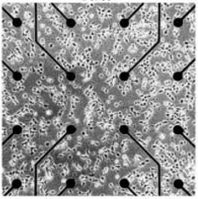
Data collection methods
Multi-electrode Arrays (MEA)
8 by 8 grid of electrodes/channels
200 μm apart
When charge is passed across a synapse, it is detected as a “spike”
200 μm
This is an electrode/channel

Slide 4
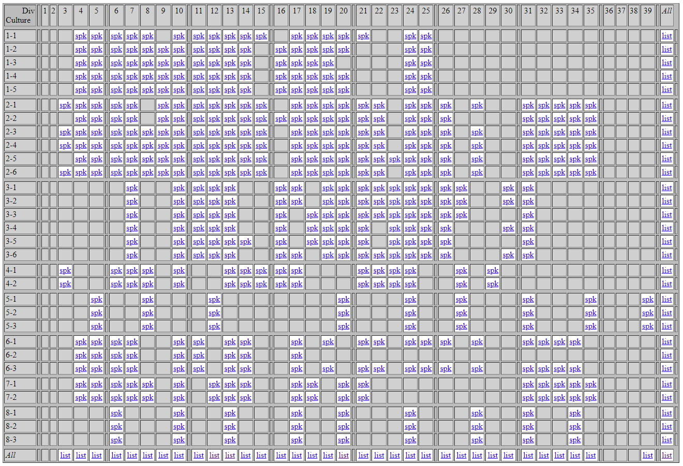
Notes:
Describe what’s happening, point out missing days

Slide 5
Challenges with dealing with the data
Time (s) Channel
1.29948 24.0
1.53048 24.0
1.61572 7.0
3.01584 59.0
3.09744 52.0
3.14832 59.0
3.29296 59.0
3.5088 59.0
3.50968 59.0
3.69272 24.0
3.70892 52.0
3.71644 24.0
3.87128 24.0
3.89728 24.0
3.9532 24.0
3.95608 46.0
4.18088 23.0
4.18512 53.0
Time-series like data
Each file is zipped
The files are typically around 20000 to 40000 lines long, to start off with, and increase to about ten times this at about day 25
Many days with no data at all
Notes:
Requests
BZ2
regex

Slide 6
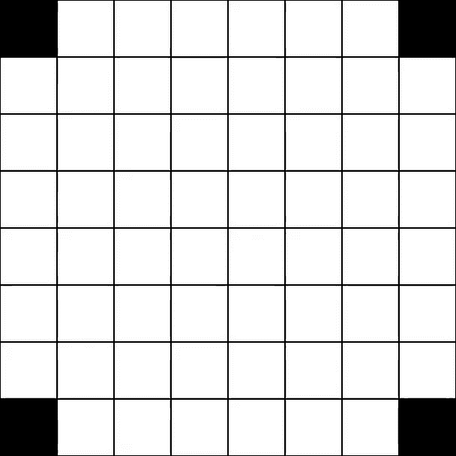
Step 1 - simulation
pygame
Render the screen
Take screenshots
imageio
Stitch together images to make video
Allowed for better collaboration
os
Create folders relative to the folder the program was in
Allowed for program to be run on other laptops
Early time (day 4)
Notes:
Didn’t have to wait for simulation to run before we could discuss results.
Os: program could be run on other people’s laptops.

Slide 7
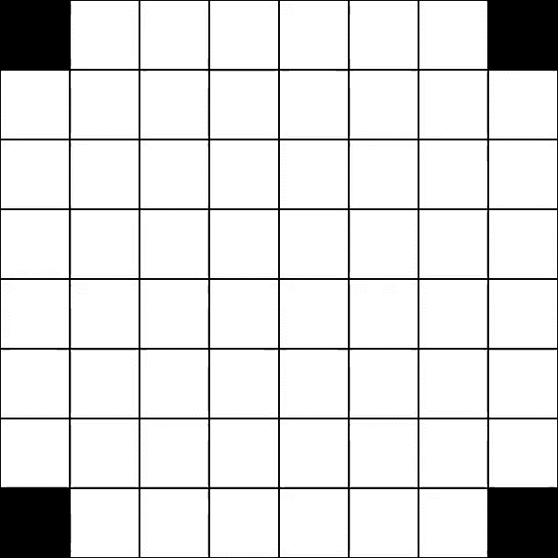
Spot the difference!
Late time
About 10 times more spikes in a day
Late time (day 25)
Notes:
Ffmpeg?

Slide 8
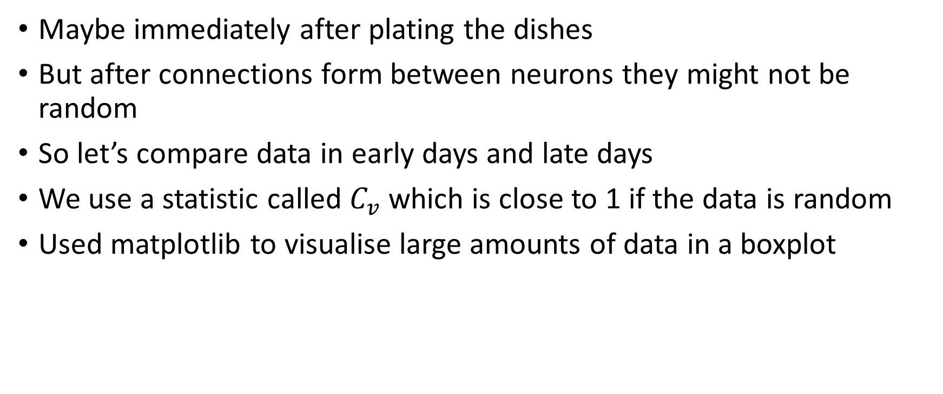
Testing randomness
Maybe immediately after plating the dishes
But after connections form between neurons they might not be random
So let’s compare data in early days and late days
We use a statistic called $C_{v}$ which is close to 1 if the data is random
Used matplotlib to visualise large amounts of data in a boxplot

Slide 9
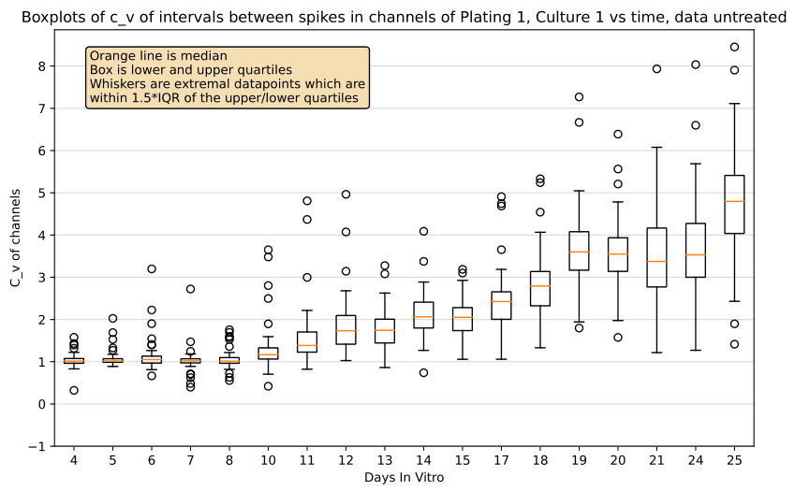
Progression of C_v values for one culture
C_v close to 1 means random data

Slide 10
Importance of optimisation
Large data sets (~300000 lines of data for each plating-culture-day)
Learned about Azure Virtual Machine
Automation is the name of the game (I learnt this the hard way)
Notes:
Sped up workflow, by running a long program on one machine and using my local machine to carry on developing
Used Git to sync between the two seamlessly
Azure VM had 16 CPU cores and a larger memory, crunching numbers two or three times faster than my machine

Slide 11
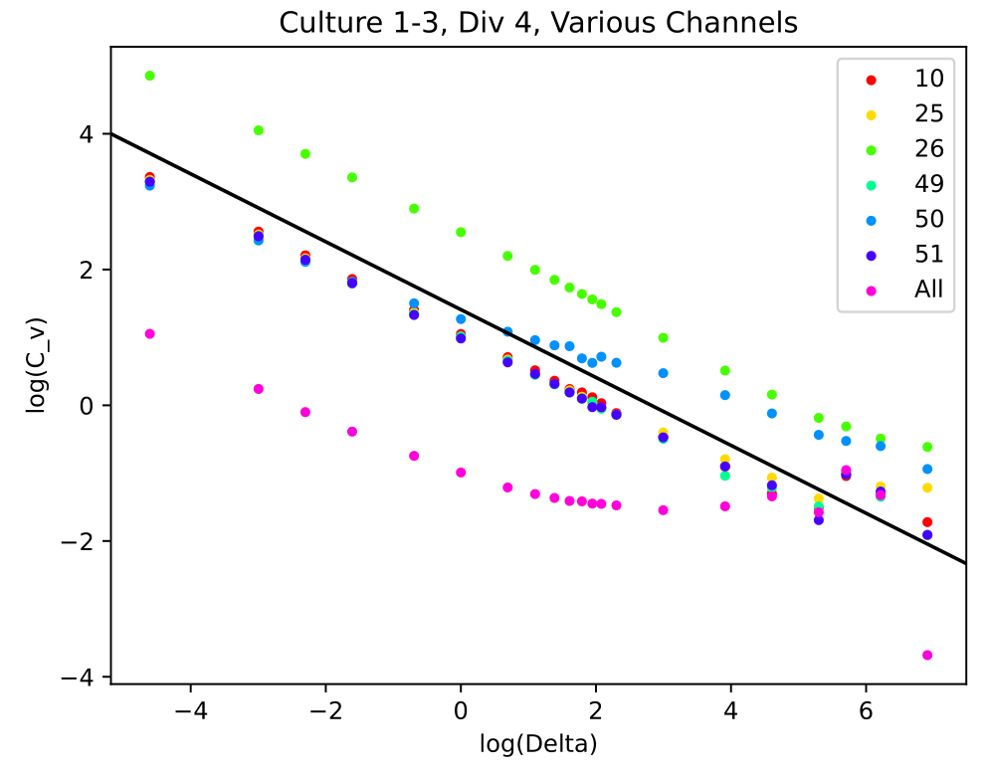
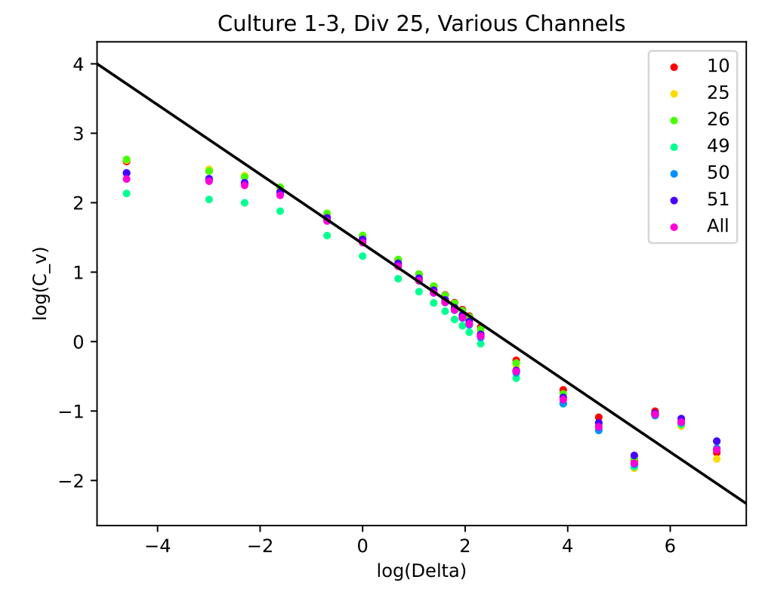
Power law relation between Poisson variable and its C_v
Black line has slope -1/2
Early time
Late time
Notes:
The black line is a guide to the eye, demonstrating that the power law relationship does indeed hold. The intercepts are not as important (they relate to the parameter lambda)
Fun exercise to program and use the statistics that we got taught at school and university in a useful setting.

Slide 12
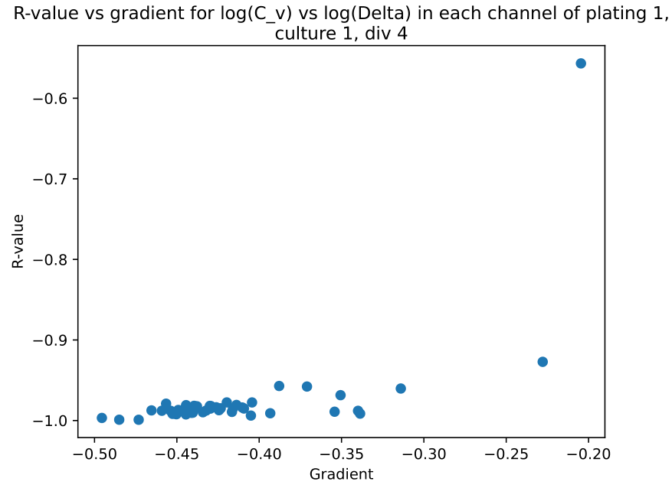

Slide 13
Making programs modular
Realised that I did not want to do every step in one program in case of failure at any one point, because this was slow.
Made different programs for different parts of the task
Made my own python “module” which I could just take common functions from instead of writing them again
Notes:
Calculating C_v values (VM) and storing them in a CSV file
Calculating the linear regressions using data from CSV files
Plotting Graphs
Retrieving and parsing data from the website
Creating a LaTeX file for collaging images together for easy comparison, access and storage of results, Translating between channel numbers and channel coordinates

Slide 14
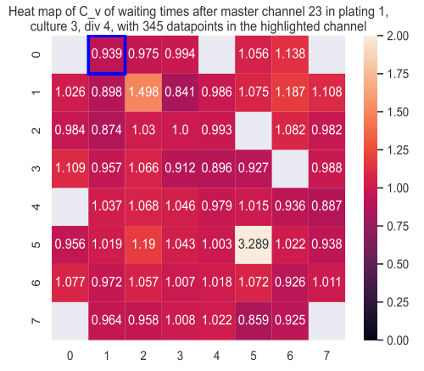
Heatmaps
Highlighted channel is a master channel being compared with
Close to magenta means independent (random) channels
Seaborn module used to make heatmap
Visually see the stats for individual channels and quickly infer what’s happening

Slide 15
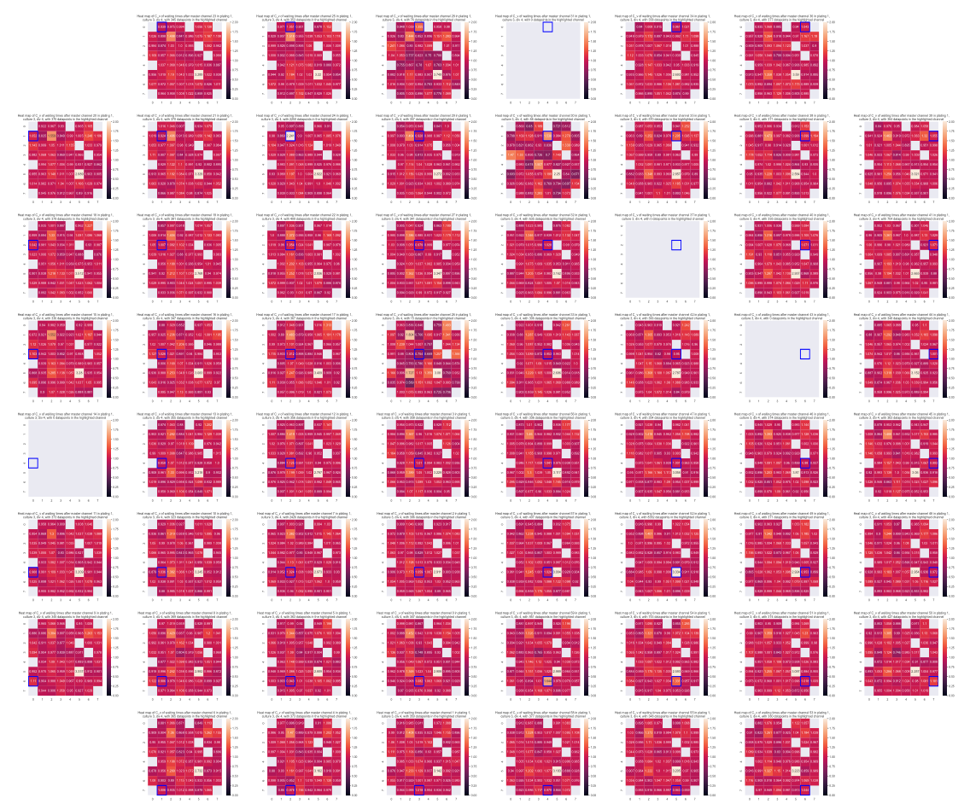
C_v 1 is typical across all master channels
Made a collage of these for every master channel
Vector images, so can zoom in
Useful for discussing results and collaborating
Notes:
Used LaTeX to compile many heatmaps into one vector image
E.g. it is very easy to see broken electrodes
Made a python program which made a LaTeX script with the appropriate jpeg images in it
Ran the LaTeX scripts en masse to make the image, using Vim + VimTex as a compiler

Slide 16
Summary
Automation is very useful
Timing programs to measure efficiency
Labeling figures
Commenting code
Report to keep track
Notes:
Summary of the things I learned over this project
VM, requests, bz2, saving figures.

Slide 17
Thank you for listening!

Slide 18
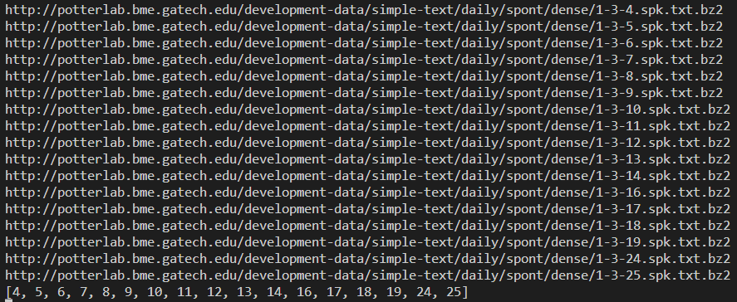
Unexpected use of regex

Slide 19
Unexpected use of regex
Needed to create x-axis for graph
Had a list of files with which I got the data
Needed a way to get the day numbers
Regex is a neat way of finding them
Notes:
I knew they existed, but it was exciting to actually use them in a place in which they were needed. Still maybe overkill, but it was faster in some tests.

Slide 20
Conclusion
We have shown that in early time the intervals between spikes follows an exponential distribution and is random
Later on it doesn’t look random, so maybe there are some connections!
Up till now we’ve been looking at each channel separately
Let’s look at relations between channels now.

Slide 21
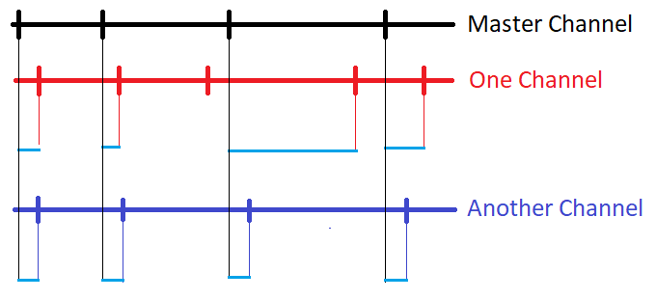
Comparative time intervals
Notes:
Which one looks most correlated?

Slide 22
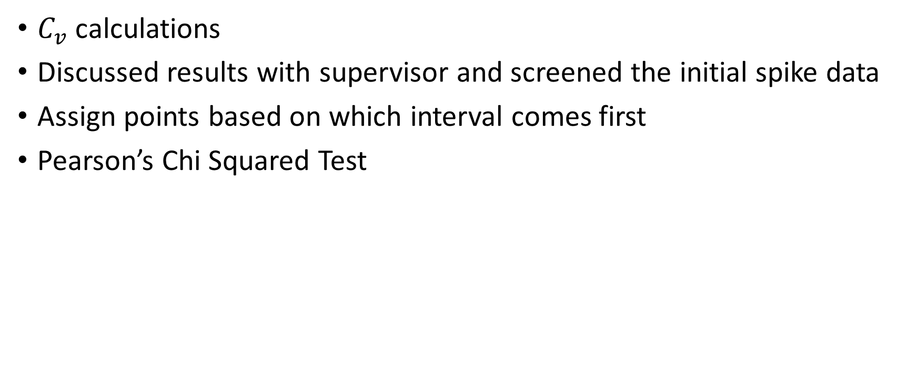
Techniques used to compare these comparative time intervals
$C_{v}$ calculations
Discussed results with supervisor and screened the initial spike data
Assign points based on which interval comes first
Pearson’s Chi Squared Test

Slide 23
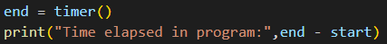
It’s the little things in life…
Always important to time programs to make sure I knew roughly how long they would take, and evaluate if that was a reasonable length of time (by considering the rough time complexity)
This is how the message evolved throughout the project
In its final evolution, it not only tells me how long the program took to run, but also the filename!

Slide 24
Extra Slides
Research project, visuals for hobby projects
Notes:
Hello everyone, nice to see everyone’s talks today. Today I want to talk about what I’ve been doing over the summer, which is trying to find patterns in data collected on neurons, and they way they fire.

Slide 25
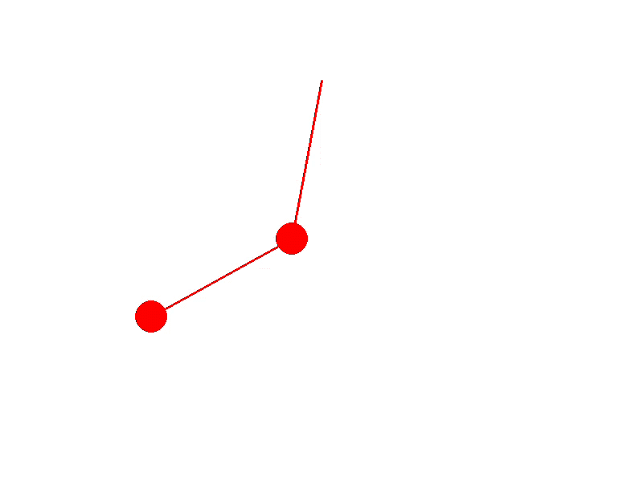
Double Pendulum
Pygame
Euler Integration
Cool because since coding it I have learnt of
Runge Kutta integration
How to derive the equations of motion with a Lagrangian

Slide 26
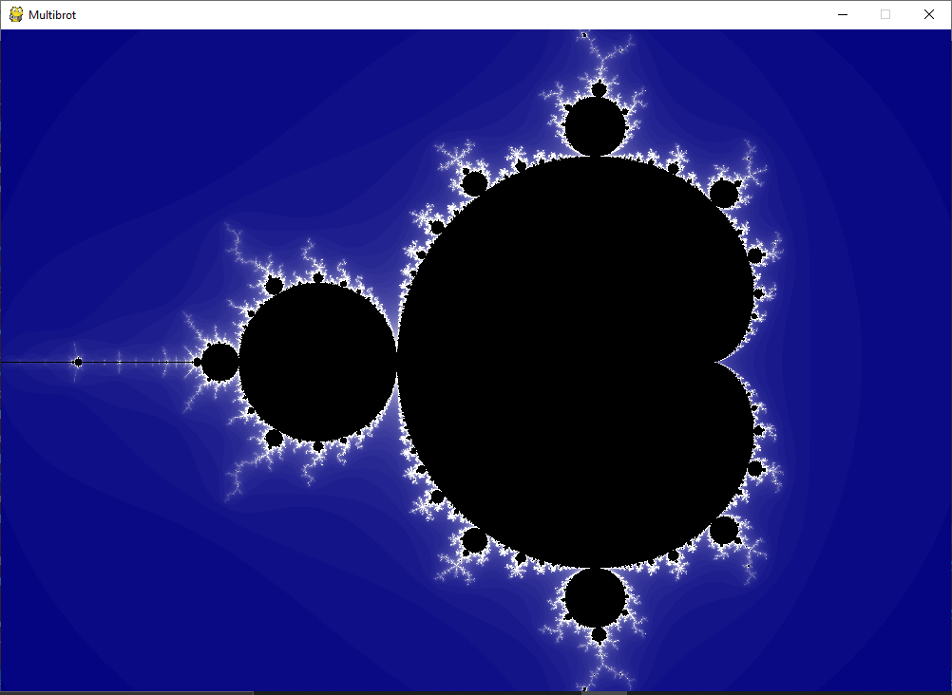
Mandelbrot set
Very satisfying when it worked
My first experience with collaboration
Showed it to a university friend and he suggested a different exponent
Ended up using the same program to render a whole class of fractals called “Multibrot sets”
Fun to optimise (e.g. only render the top half, or stop doing calculation when the modulus exceeds 2)

Slide 27
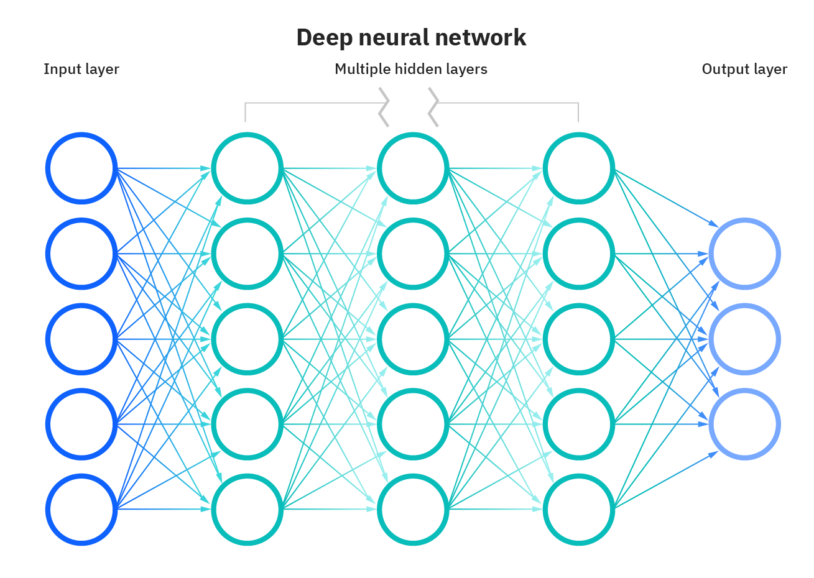
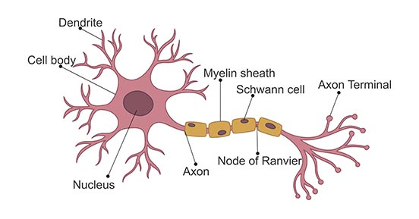
Not the neural network you’re thinking of
Beggs and Plenz [2003] “Neuronal avalanches in neocortical circuits”
Notes:
Every time I describe my project to someone, they think I’m doing some kind of machine learning or AI thing, but this is rather more interesting! We’re looking at actual biological neurons, and we want to understand how they network. It is true though that one of the many reasons to study neurons is to refine how we implement neural networks, and this was one of the applications cited in the [Beggs and Plenz 2003] paper - indeed artificial neural networks are inspired by neurons.

Slide 28
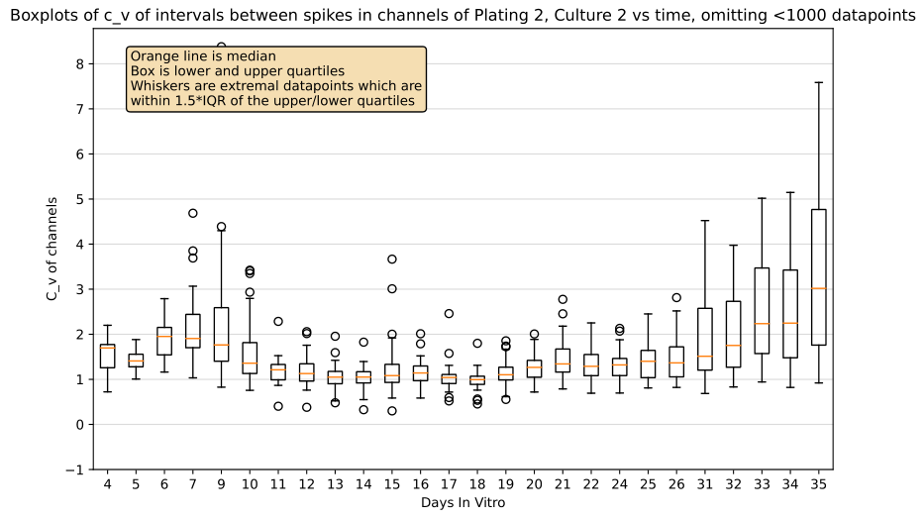
Progression of C_v values for a different culture
Death of cells
Notes:
In order to clean up the data, we omitted data from channels with less than a 1000 data points, deeming them to be too sparse. This did improve things slightly, resulting in far fewer outliers.

Slide 29
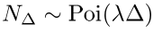
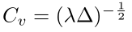
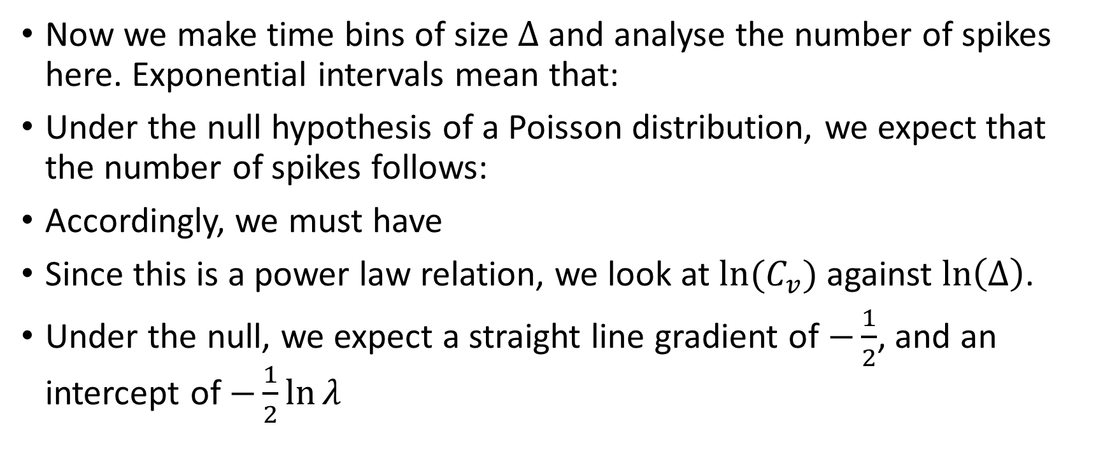
Method 2 for testing randomness: Number of spikes in a time bin
Now we make time bins of size $Δ$ and analyse the number of spikes here. Exponential intervals mean that:
Under the null hypothesis of a Poisson distribution, we expect that the number of spikes follows:
Accordingly, we must have
Since this is a power law relation, we look at $ln⁡(C_{v})$ against $\ln\left(Δ\right)$.
Under the null, we expect a straight line gradient of $−\frac{1}{2}$, and an intercept of $−\frac{1}{2}\ln{λ}$

Slide 30
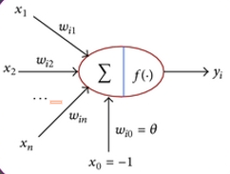
Cascades, Bursts and Avalanches
D. A. Wagenaar, J. Pine, and S. M. Potter [2006] “An extremely rich repertoire of bursting patterns during the development of cortical cultures”
Notes:
Let’s briefly have a refresher on what neurons are. There is a lot more complexity to this, but the gist is that neuron’s send signals from one to another much like wires do, by transferring electrical charge!
Potentials are added up from its inputs, called Dendrites, and once a threshold is reached it sends its own potential across to another neuron through an axon.
There are typically more dendrites than axons, and due to the structure of this system, it makes sense that the charges are, in some way, concentrated, and we should expect that over some time, we get bursts of activity, as many neurons fire in quick succession.
This behaviour has been observed, and has been classified into different types of bursts in Wagenaars paper (apologies for mispronouncing the name!)
[These bursts have also been observed in the spinal cord, retina, cortex and hippocampus. In my project, though, I focused on cortical cultures developed in vitro.]

Slide 31
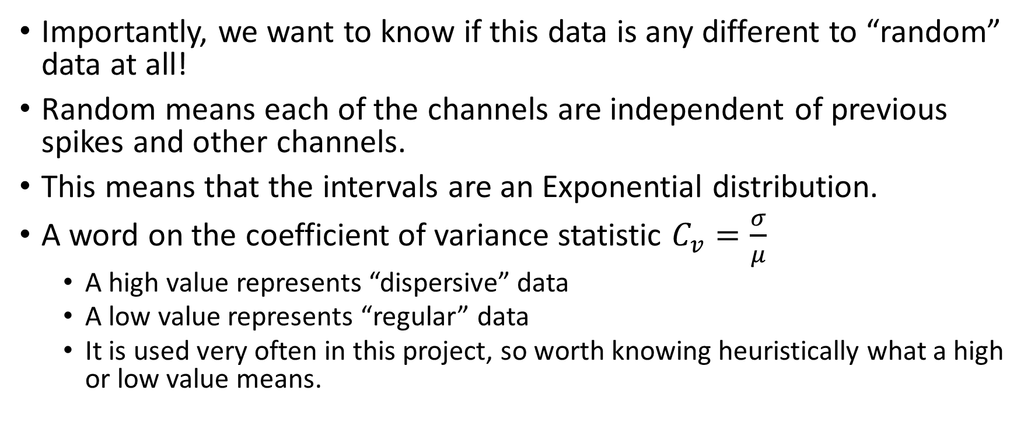
Step 2 – is the data random?
Importantly, we want to know if this data is any different to “random” data at all!
Random means each of the channels are independent of previous spikes and other channels.
This means that the intervals are an Exponential distribution.
A word on the coefficient of variance statistic $C_{v}=\frac{σ}{μ}$
A high value represents “dispersive” data
A low value represents “regular” data
It is used very often in this project, so worth knowing heuristically what a high or low value means.
Notes:
Dispersive data is where the time intervals between successive spikes are even more erratic than what we would expect from completely random data. It can mean something like lots of data close together, followed by large gaps.

Slide 32
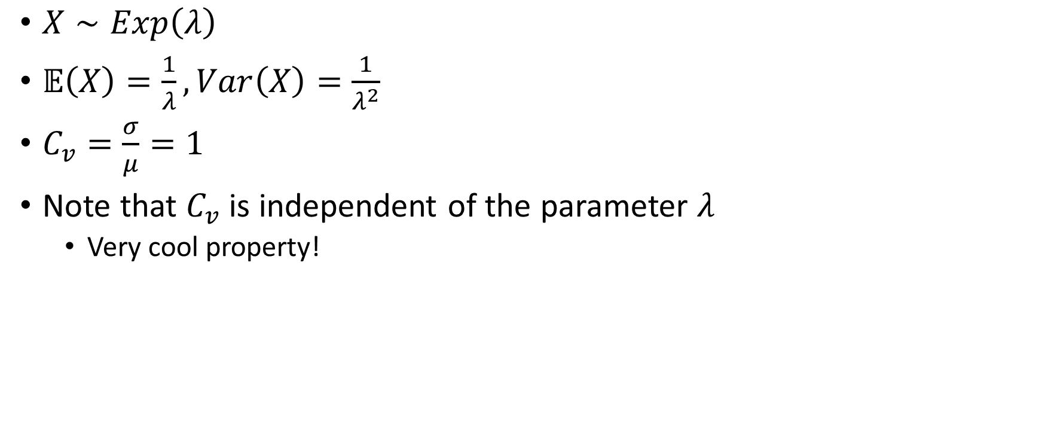
Interval times between spikes
$X∼Exp\left(λ\right)$
$𝔼\left(X\right)=\frac{1}{λ}, Var\left(X\right)=\frac{1}{λ^{2}}$
$C_{v}=\frac{σ}{μ}=1$
Note that $C_{v}$ is independent of the parameter $λ$
Very cool property!

Slide 33
Links between channels
If there are connections from the master channel to some other channel then maybe the waiting times are similar size
This means that they are regular, which means a low C_v
So let’s look for low C_v’s!

Slide 34
C_v of waiting times for early time
Close to purple (C_v=1)
Channels independent

Slide 35
C_v 1 is typical across all master channels
True regardless of master channel chosen!
Notes:
That was with master channel 23 (highlighted in blue). The same procedure was done with every master channel. This gives us a heatmap of heatmaps, which is amusing to think about.

Slide 36
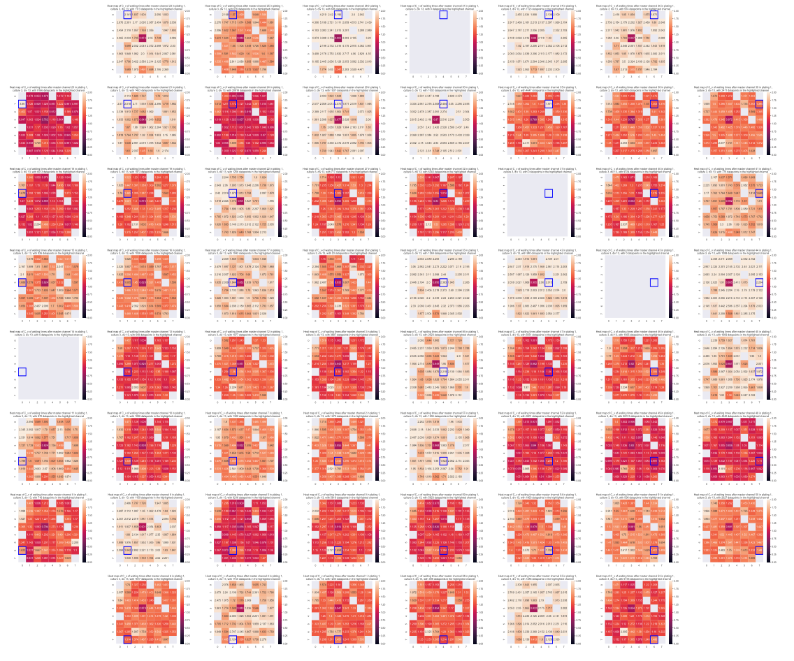
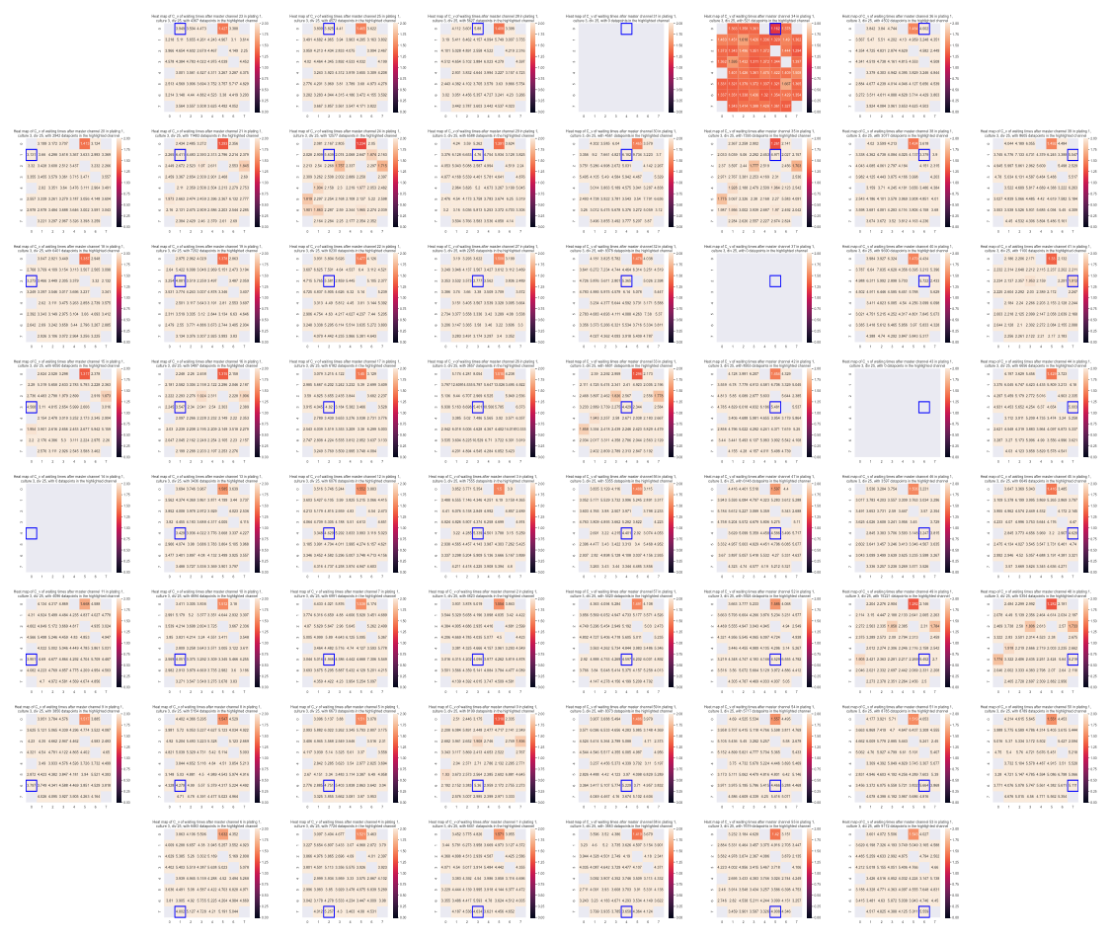
C_v values for later time are higher (day 13, day 25)
Notes:
Remember we’d expect some kind of connections to be made so we’d get lower values of c_v? Well it seems the opposite is true! The waiting times just get more and more dispersive. Any dark boxes were from those.

Slide 37
Probabilistic nature of neurons firing
Unexpected result - the C_v just got higher and higher.
This isn’t good! It seems that the waiting times before the next channel fires just gets more and more dispersive. Note that this doesn’t mean more “random”.
We conjecture that the dispersion is due to failed firings
Restrict to waiting times smaller than some fixed time interval
This didn’t work too well either!

Slide 38
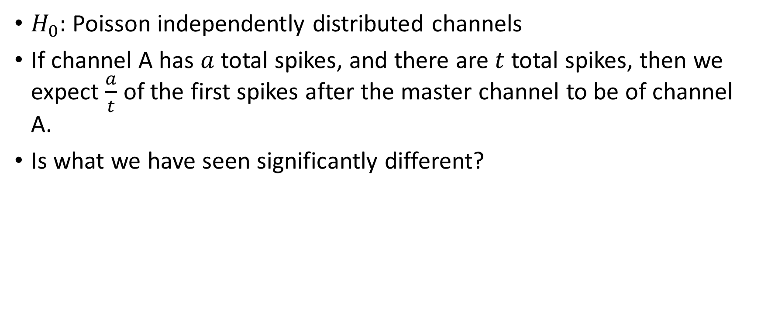
Chi-squared Test
$H_{0}:$ Poisson independently distributed channels
If channel A has $a$ total spikes, and there are $t$ total spikes, then we expect $\frac{a}{t}$ of the first spikes after the master channel to be of channel A.
Is what we have seen significantly different?

Slide 39
Workflow
Freedom to experiment with different techniques and styles
Roughly weekly meetings with Dr Pausch where we discussed interesting aspects of the data, and what direction the project would go next.
Kept a report in LaTeX to store diagrams, figures and statistics to help communicate with my supervisor.
Length of project allowed me to spend lots of time improving programming practice, and learning a lot!

Slide 40
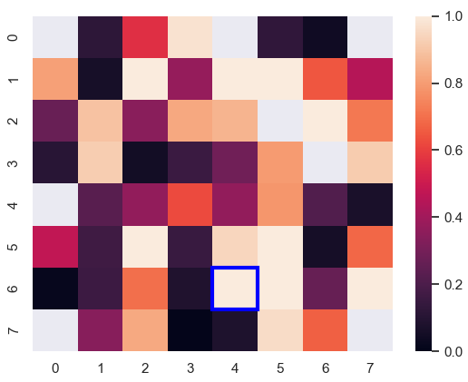
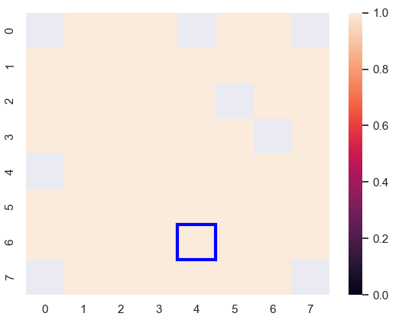
P-values in early time vs late time. (It gets larger)
Notes:
Easier and easier to reject null as time progresses.

Slide 41
Further Questions
Can we extract any connections between channels?
Can we extract a network from the data?
Is it possible to see causal relationships between channels?
How does this real data compare when running a similar experiment on simulated neurons?

Slide 42
Full references
Beggs JM, Plenz D: Neuronal avalanches in neocortical circuits. J Neurosci 2003, 23(35):11167-11177.
D. A. Wagenaar, J. Pine, and S. M. Potter, 2006, "An extremely rich repertoire of bursting patterns during the development of cortical cultures", BMC Neuroscience, 7:11
Wagenaar DA, DeMarse TB, Potter SM: MEABench: A toolset for multi-electrode data acquisition and on-line analysis.Proc 2ndIntl IEEE EMBS Conf on Neural Eng 2005:518-521.

Slide 43
Thank you for listening

Slide 44
Notes:
Look at that! A confirmation of what we could see already – all 59 channels are very straight lines, and with gradient close to -0.5

Slide 45
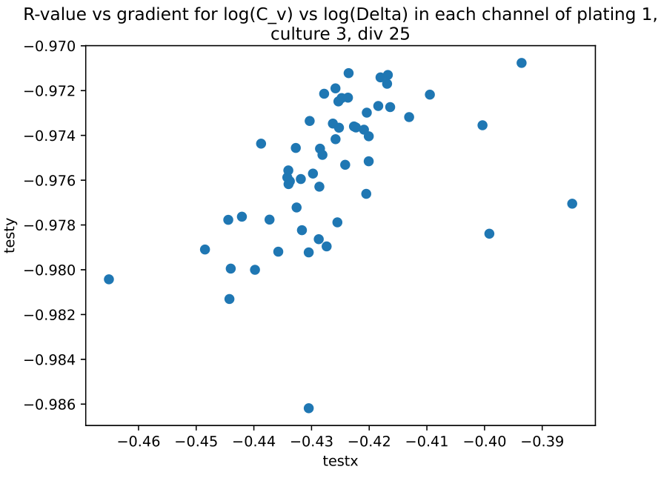
Notes:
At day 25, the lines are still quite straight, but with a lower gradient in general. This seems to suggest that a Poisson distribution is not a bad guess, but not the best model.

Slide 46
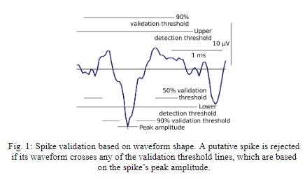
Data collection – spikes
Wagenaar et al. [2005]
Notes:
The danger is of oversuppressing or under suppressing. We don’t know the true state of what is or isn’t noise, and what is or isn’t a spike. A clean window is one where the data in the window is not completely blanked out. Another problem is that a spike often results in secondary spikes closely after. But these are typically cause by one action potential, so are screened out.

Slide 47
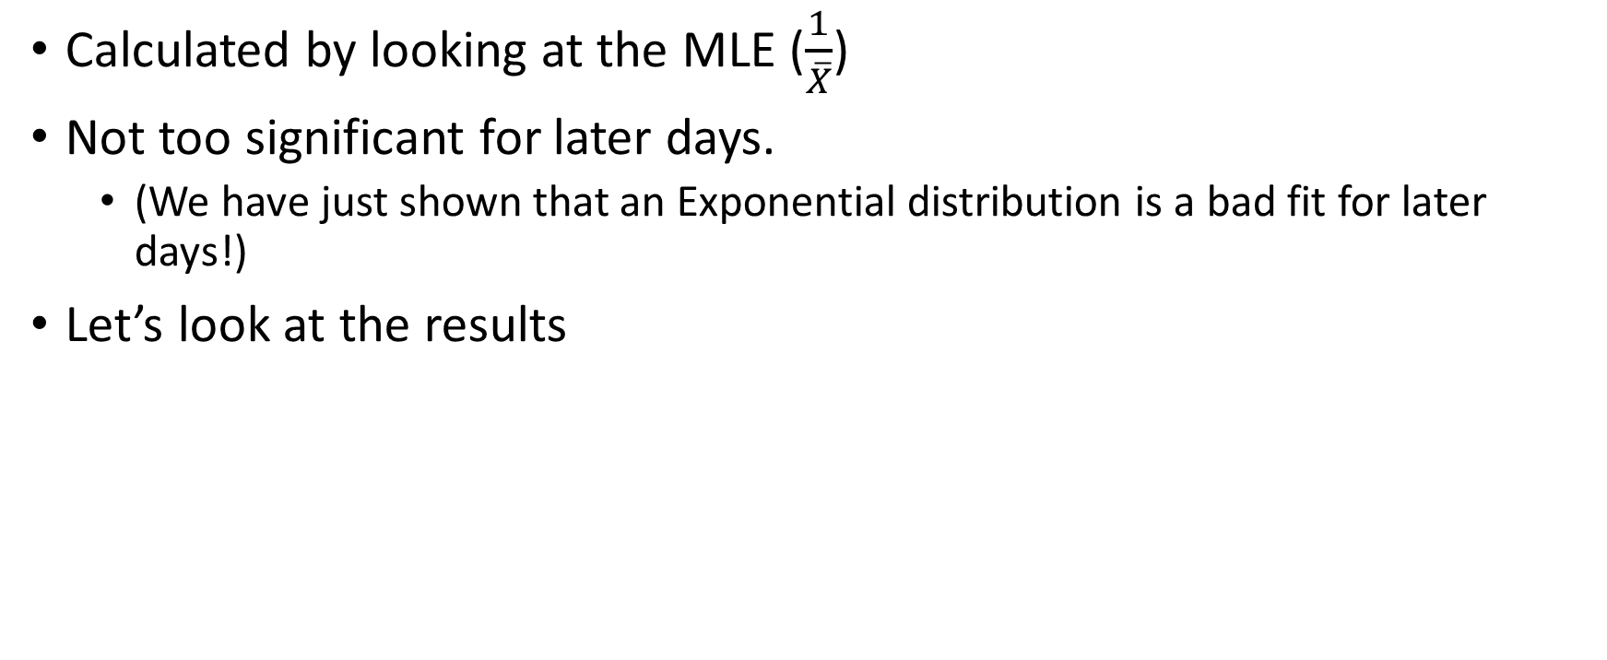
Estimating lambda
Calculated by looking at the MLE ($\frac{1}{\overline{X}}$)
Not too significant for later days.
(We have just shown that an Exponential distribution is a bad fit for later days!)
Let’s look at the results
Notes:
Filtered out high variance estimates.

Slide 48
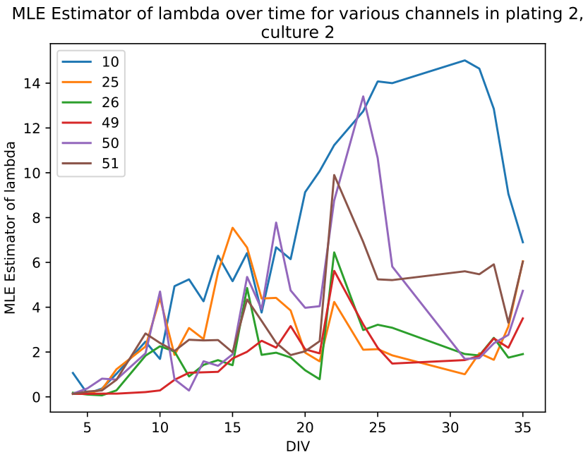
Notes:
The estimated value of lambda increases for all of the selected channels, which is expected, because they all spike more and more frequently as time goes on. This is a particularly nice one.

Slide 49
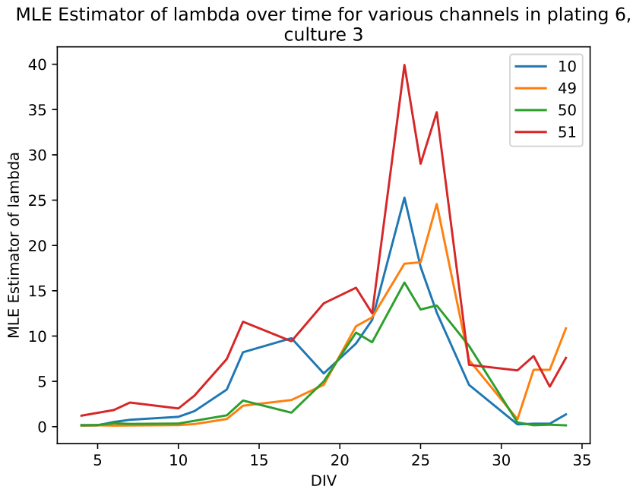
Death of cells
Notes:
This was an interesting culture in which we conjecture that many of the cells started dying after day 25.

Slide 50
Proportion of spikes which occur directly after
How else can we judge whether two channels are connected?
Let’s assign points to whichever channel spikes first after the master channel.

Slide 51
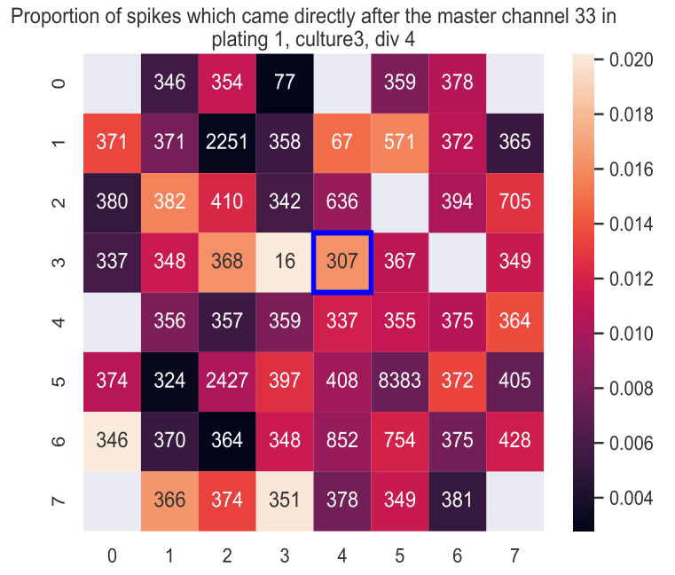
Notes:
Once again there did not see to be any connection between channels – most of them looked like this, even across various days.

Slide 52
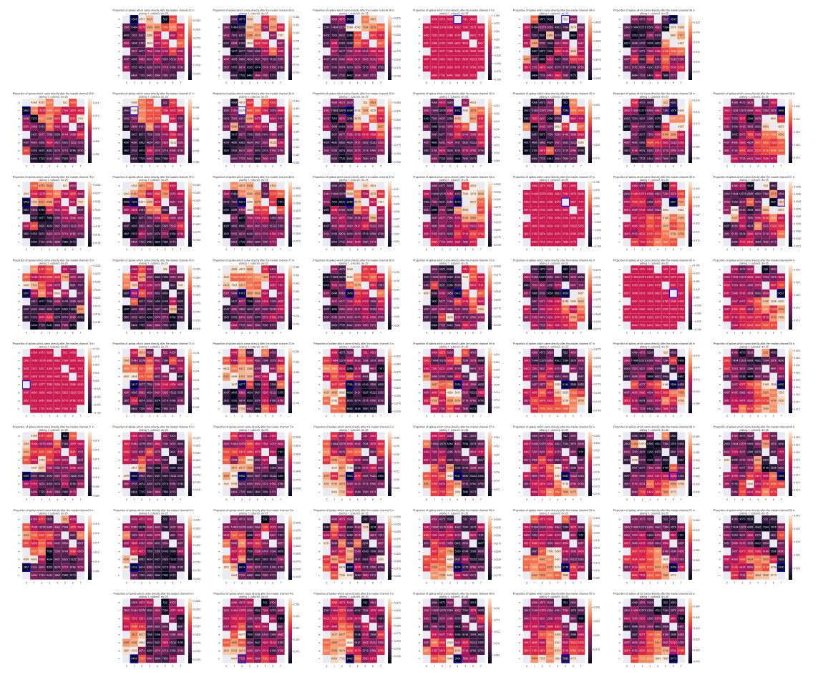
Notes:
Brighter colours in their region? Regional connections?

Slide 53
Method 2 for testing randomness: Number of spikes in a time bin
Now we make time bins of size $Δ$ and analyse the number of spikes here. Exponential intervals mean that:
Under the null hypothesis of a Poisson distribution, we expect that the number of spikes follows:
Accordingly, we must have
Since this is a power law relation, we look at $ln⁡(C_{v})$ against $\ln\left(Δ\right)$.
Under the null, we expect a straight line gradient of $−\frac{1}{2}$, and an intercept of $−\frac{1}{2}\ln{λ}$

Slide 54
Early time (day 4)
Black line has slope -1/2
Notes:
The black line is a guide to the eye, demonstrating that the power law relationship does indeed hold. The intercepts are not as important (they relate to the parameter lambda)

Slide 55
Late time (less of a straight line)
Black line has slope -1/2
Notes:
These are the same channels at day 25, and it really does not seem to be a straight line. It is interesting to see how much more closely bunched they are, though.

Slide 56
Conclusion
We have shown that in early time the intervals between spikes follows an exponential distribution and is random
Later on it doesn’t look random, so maybe there are some connections!
Up till now we’ve been looking at each channel separately
Let’s look at relations between channels now.

